Slide 1

Housing Marketplace Web Application
Presented By,
Nafis Fuad Tanvir
ID: 201002437
Md. Arif Hasan Rifat
ID: 203002049

Slide 2
Table of Contents
Introduction
Project Functionality
High Level Design
Low Level Design
ER Diagram
Test Case
Tools and Technologies
Future Scopes
Conclusion

Slide 3
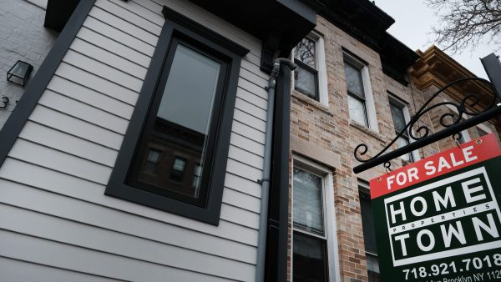
Introduction
The real estate industry is a significant sector of the economy that plays a pivotal role in connecting buyers and sellers of properties. As society embraces the digital age, there is a growing demand for online housing marketplace that simplify property searches, streamline communication, and provide a wealth of information for prospective buyers, renters, sellers, and agents.

Slide 4
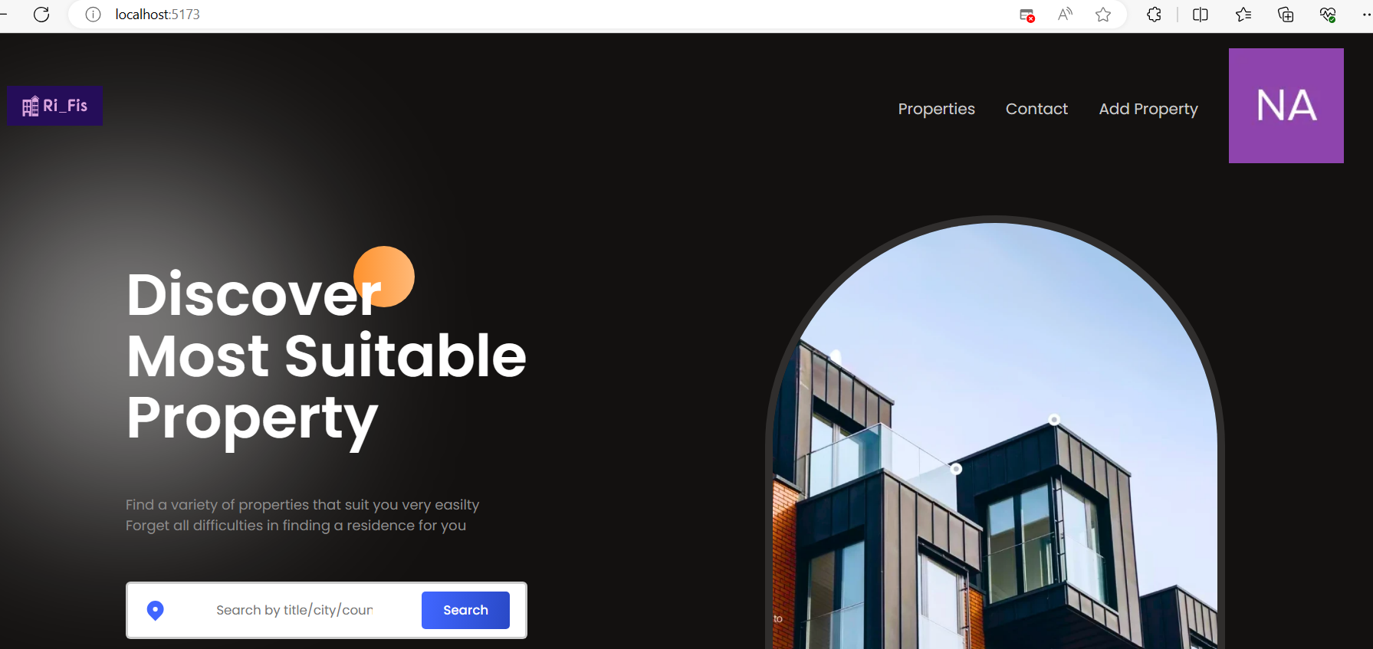
Project Functionality
When you will login in our website you can find these functionality like below figure.

Slide 5
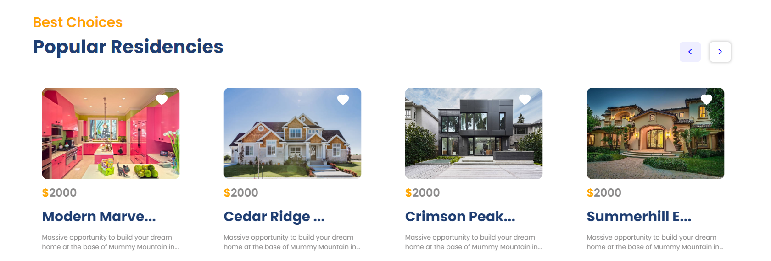
Project Functionality (cont.)
Here, we add a slider so that we can see multiple properties by scrolling right and left.

Slide 6
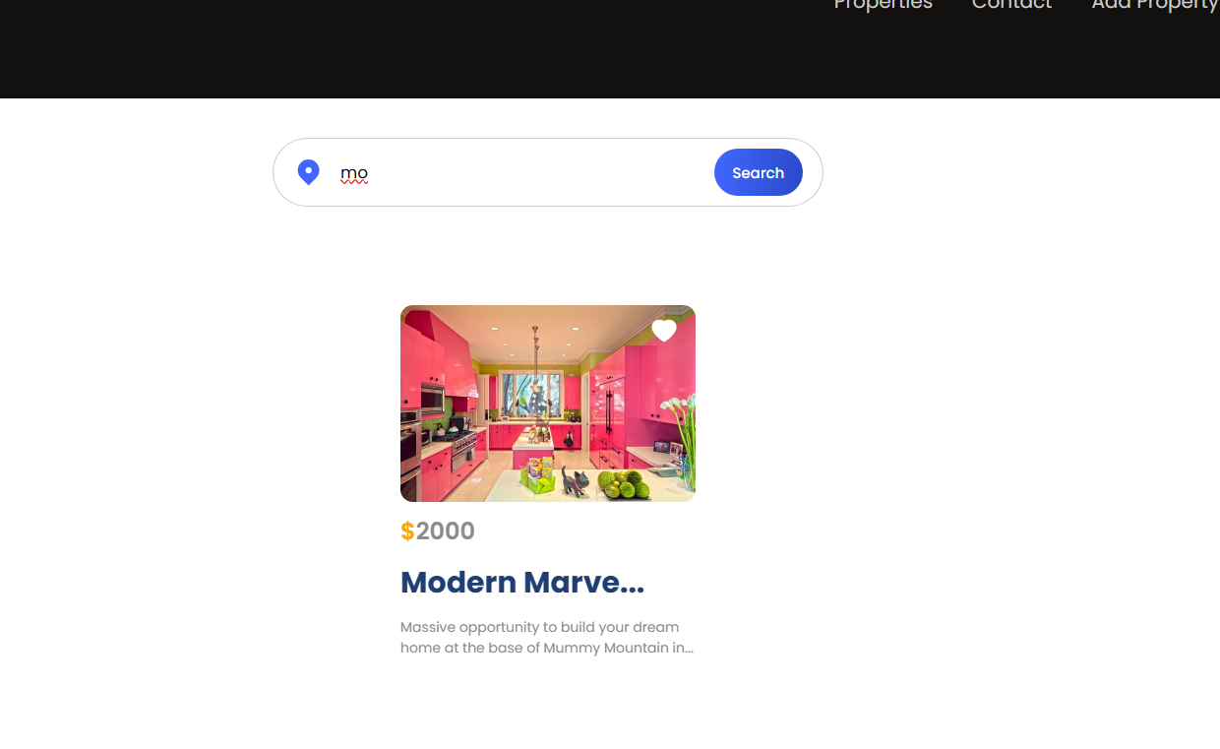
Project Functionality (cont.)
Here, you can see we can search a property by using a short name

Slide 7
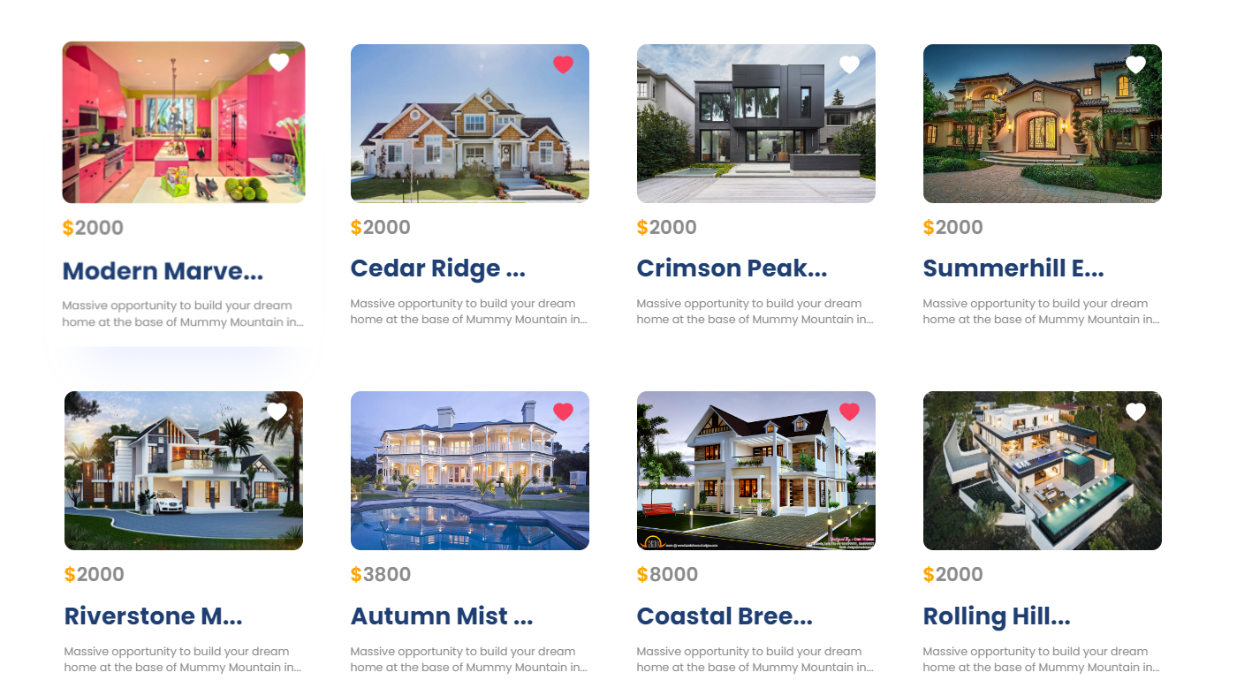
Project Functionality (cont.)
Here, you can see our property list that available in our website. Also, we can give a liked to a property.

Slide 8
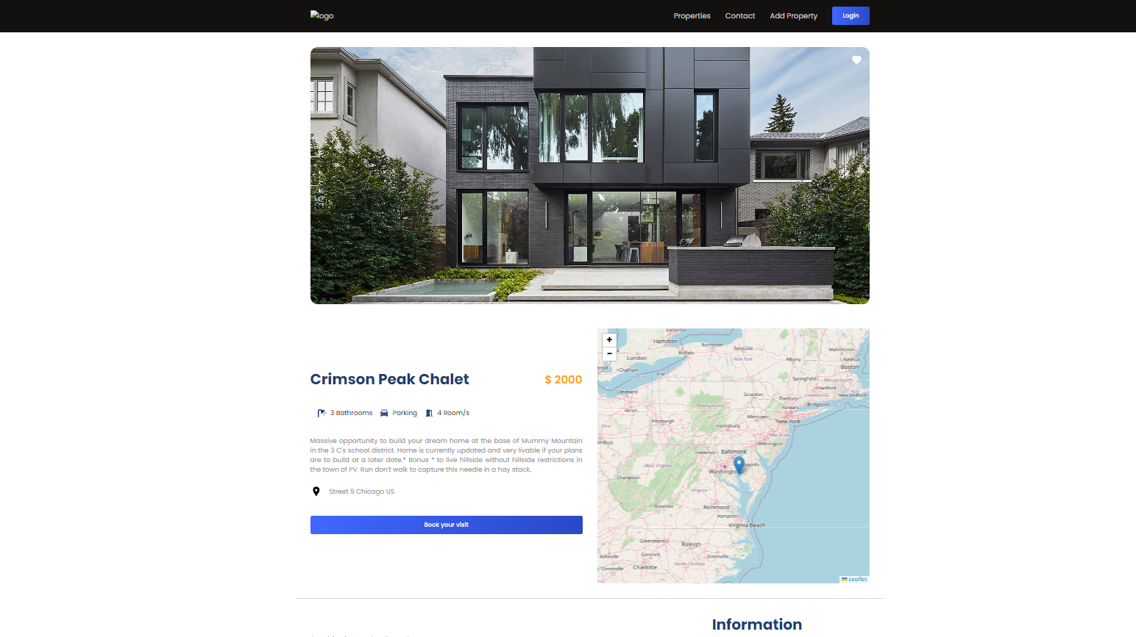
Project Functionality (cont.)
Here, you can see we can book a visit to see our liked property but at first, we have to login for that.

Slide 9
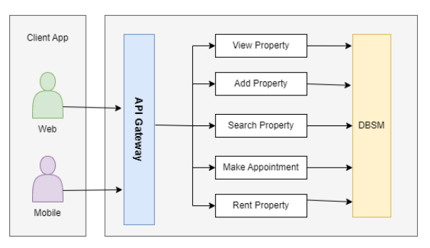
High Level Design
High-level design (HLD) is a macro-level design that provides a high-level view of the system's architecture and design.
Figure: A client-server architecture

Slide 10
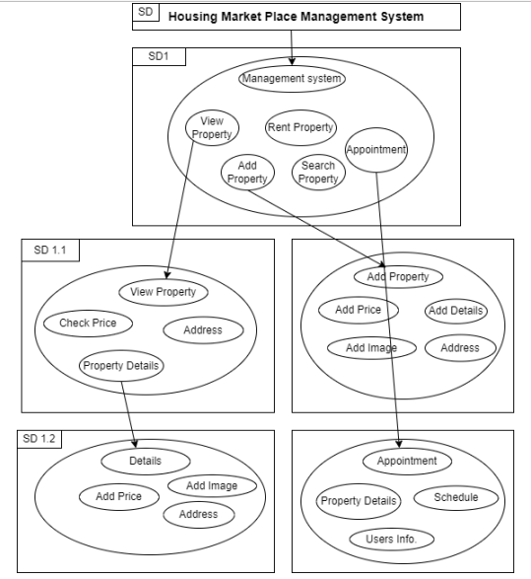
Low Level Design
LLD, or Low-Level Design, is a phase in the software development process where detailed system components and their interactions are specified.
Figure: High level view to low level view

Slide 11
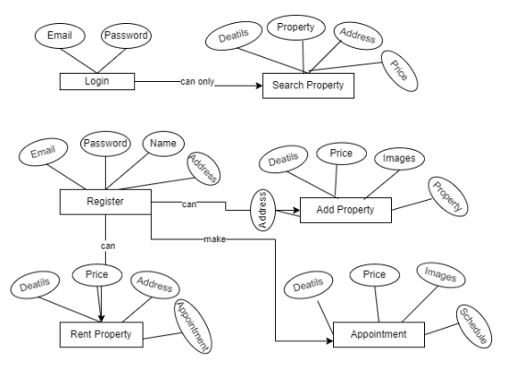
ER Diagram
An Entity Relationship (ER) diagram, also known as an ERD, is a visual representation of the relationships between entities in a database. ER diagrams are used to model real-world objects like people, objects, or concepts, and the relationships between them.
Figure: ER Diagram

Slide 12
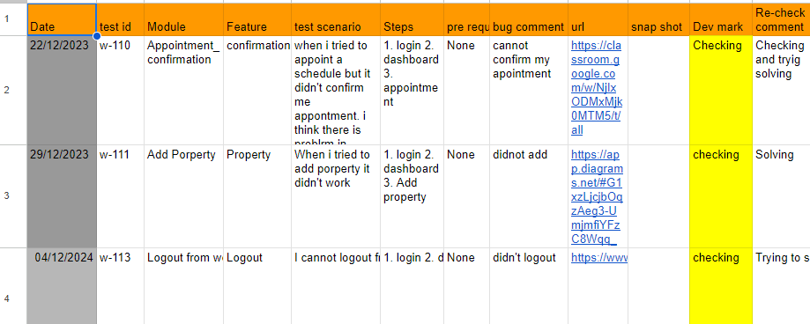
Test Case
Test Report is a document which contains a summary of all test activities and final test results of a testing project. Based on the test report, stakeholders can evaluate the quality of the tested product and make a decision on the software release.
Figure: Manual test report

Slide 13
Tools and Technologies
Backend:
Node js
Express js
MongoDB
Auth0
Frontend:
React js
React hooks
React Router
Swiper js
Framer motion library etc.

Slide 14
Future Scopes
We still have some bugs in our project so we will try to fix it in near future. Also, we have planned:
In the future, we can implement advanced technologies such as artificial intelligence and machine learning to enhance customer experience.
We can explore more partnerships with local property owners.

Slide 15
Conclusion
The development of a website application project has become a necessity for businesses in today’s digital age. The benefits of having an online store that is accessible 24/7 to customers all over the world cannot be overstated. With the right design, user interface, and functionalities, a website can increase brand awareness, reach a larger audience, and drive sales.

